Slide 1
ADAC Year 8 Annual Meeting
ADAC Project Briefing
“Geofencing”
Dr. Shawn Butler
Assistant Term Professor
University of Alaska Anchorage

Slide 2
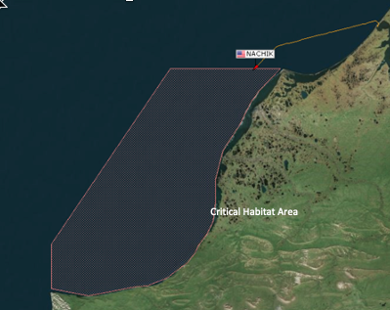
Project Geofencing: Geofencing for CG1View
ADAC Program Year 8 Annual Meeting 20-21 April 2022
Principal Investigator: Dr. Shawn Butler
Lead Institution: University of Alaska Anchorage
Supporting Team: Axiom Data Science
Project Champion: LT Evan Richter, USCG and Mr. James (Dan) Blackman
Project Advocates: Anchorage Sector, CG District 17

Slide 3
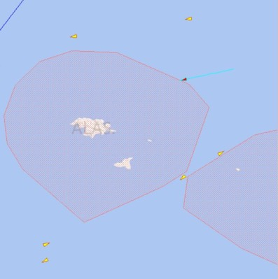
Project Geofencing: Description and Baseline
ADAC Program Year 8 Annual Meeting 20-21 April 2022
Create an application that allows the Coast Guard to create, manage, and visualize virtual geofences as an integrated component of the Coast Guard’s command and control system – CG OneView
Leverage lessons learned from AK Marine Exchange PACTRAC application

Slide 4
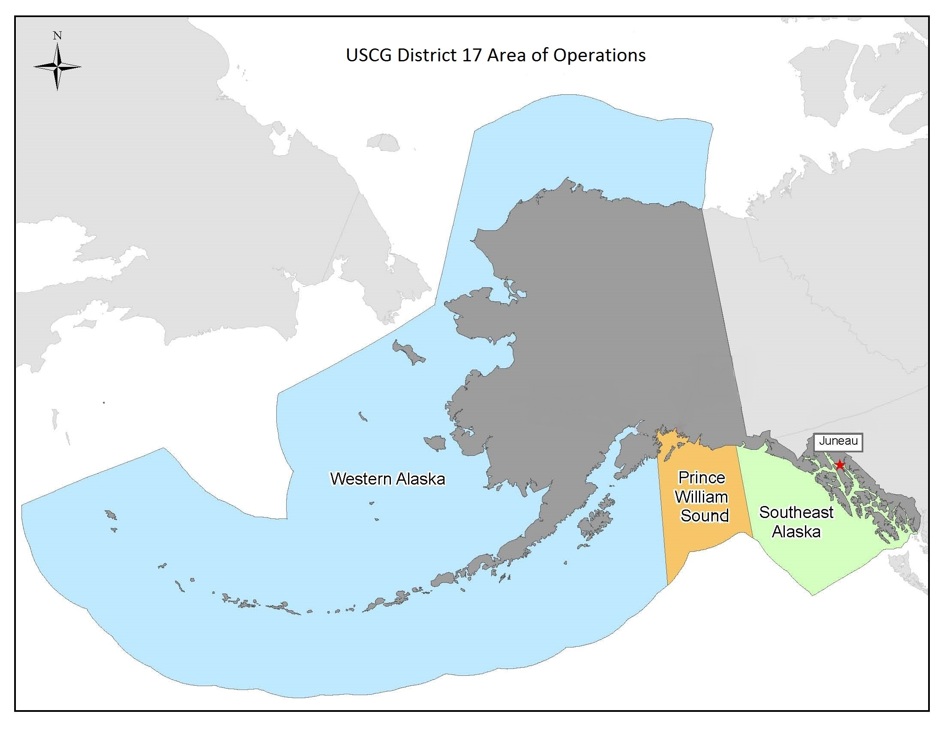
Project Geofencing: Relevance
ADAC Program Year 8 Annual Meeting 20-21 April 2022
Hundreds of ships travel the arctic waters each year
CG District 17 area of operations is over 3.8 million sq miles and more than 47,000 miles of shoreline.
Maritime traffic increased 250 percent between 2008 and 2015, and traffic is expected to increase substantially as the arctic warms
Several sensitive marine habitat areas need protected
Transiting vessels are prohibited from approaching too close to U.S. Shorelines
Vessels that lose power or cargo can pose a serious threat to the environment and other vessels
Monitoring hundreds of vessels can be overwhelming to watch operators
The Marine Exchange PacTracs system is separate from the CG Command and Control System – CG One View

Slide 5
Project Geofencing: Method
ADAC Program Year 8 Annual Meeting 20-21 April 2022
Baseline -
  AK Marine Exchange provides geofencing for their members
    Developed during the ADAC YR 5 and 6 geofencing project
    Initial Geofencing requirements were developed collaboratively with Sector 17 and private entities.
    Although a significant leap in capability,
      PacTracs is not integrated with CG One View
      Operates on a separate display screen
      Coast Guard has many more requirements due to broad range of missions
  CG OneView is designed to be open and flexible
    Other developers should be able to easily add functionality
    Program office had never attempted to integrate a 3rd party application

Slide 6
Project Geofencing: Method
ADAC Program Year 8 Annual Meeting 20-21 April 2022
Developed an application prototype that interfaces with CG OneView
  Adhered to USCG OneView documentation and architecture
  Developed USCG specific requirements
  Developed an application that allows USCG users to create, delete, and modify geofences, with more precision, and integrates into the CG One View architecture
  Alert USCG operators to vessels approaching or crossing a geofence
  Solicited feedback from Anchorage Sector on usability and functionality
  Delivered documentation and code to the USCG CG1V developers

Slide 7
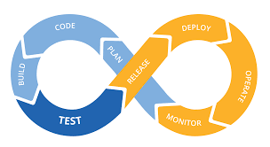
Project Geofencing
ADAC Program Year 8 Annual Meeting 20-21 April 2022
Completed Prototype
  Developed a “Continuous Integration” process for continued application development
  Developed a working prototype to the USCG for integration with CG OneView.
    The US Coast Guard has more requirements in order to make geofencing application fully operational
    Integration into CG1V should only take a few weeks.

Slide 8
Geofence Architecture
CG One View
display
ADAC Geofence Application
display
Other applications
Geofence Application
geofence messages
geofence store/retrieve
operational display
Geofence DB
USCG CG1V

Slide 9
Project Geofencing: Metrics
ADAC Program Year 8 Annual Meeting 20-21 April 2022
Current year milestones:
  Completed user prototype to create and manage geofences
  Transitioned Geofencing application to the Coast Guard
  Validated CG OneView Documentation and Interfaces
  Successful integration with CG OneView
Current year Objectives Not Accomplished:
  Evaluate final prototype with USCG Anchorage Sector
  Dynamic geofencing
  Integrate with MISLE Database

Slide 10
Geofencing: Research Outcomes
ADAC Program Year 8 Annual Meeting 20-21 April 2022
A prototype geofencing application that can be quickly integrated with CG One View
Code, requirements, and documentation transitioned to Coast Guard
  Geofence software modules
  AIS user application
  AIS stream application
  User guide for creating, editing and deleting geofences
  Geofence features video

Slide 11
Geofencing: Key Accomplishments
ADAC Program Year 8 Annual Meeting 20-21 April 2022
Requirements, Requirements, and Requirements!
Integrated geofencing application into the CG1V architecture
Opened the pathway for 3rd party developers to add capability to CG OneView

Slide 12
Project Geofencing: Transition Plans
ADAC Program Year 8 Annual Meeting 20-21 April 2022
Delivered the final prototype, documentation, to CG1V developers for integration testing and production
Currently awaiting questions or comments from developers

Slide 14
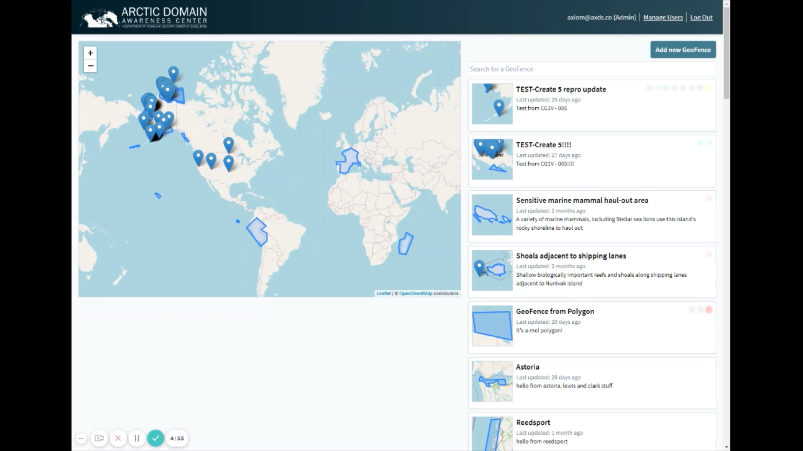

Slide 15
Ready for questions
ADAC Program Year 8 Annual Meeting 20-21 April 2022
(Insert graphic associated with the research)
?
Notes:
Thank you for the gift of your time and attention.

